Slide 1
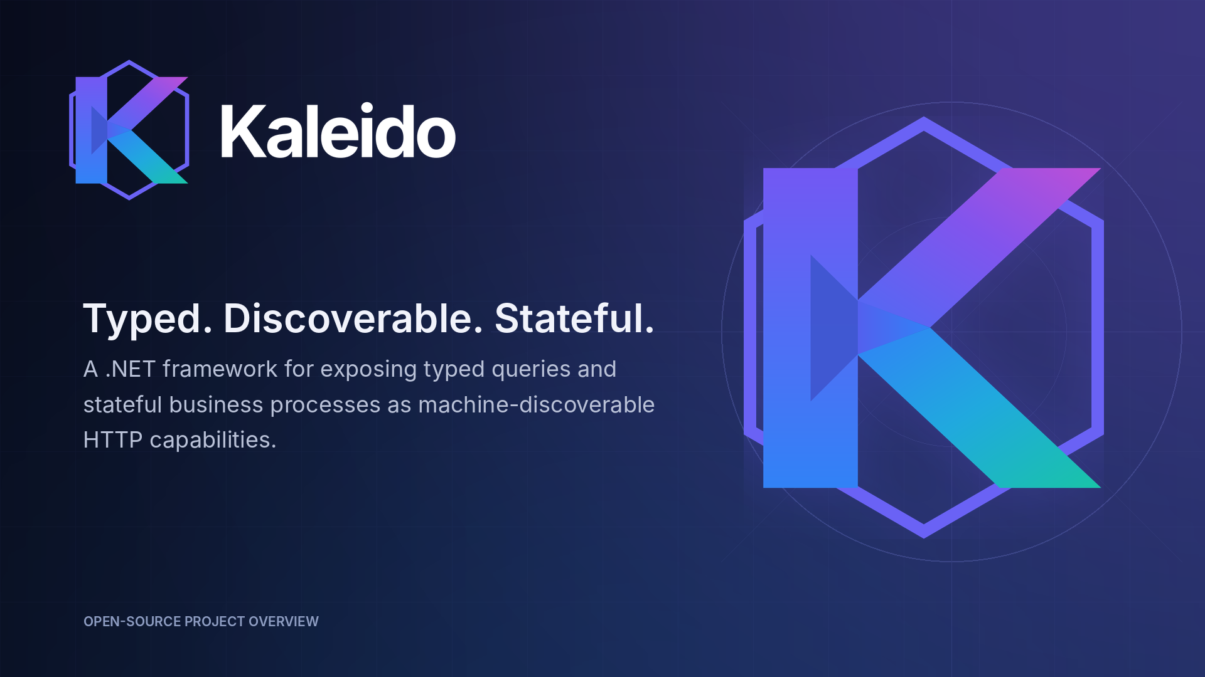
EXECUTIVE OVERVIEW
Workflows • channels • interoperability • AI
PRE-1.0 PROJECT PREVIEW

Slide 2
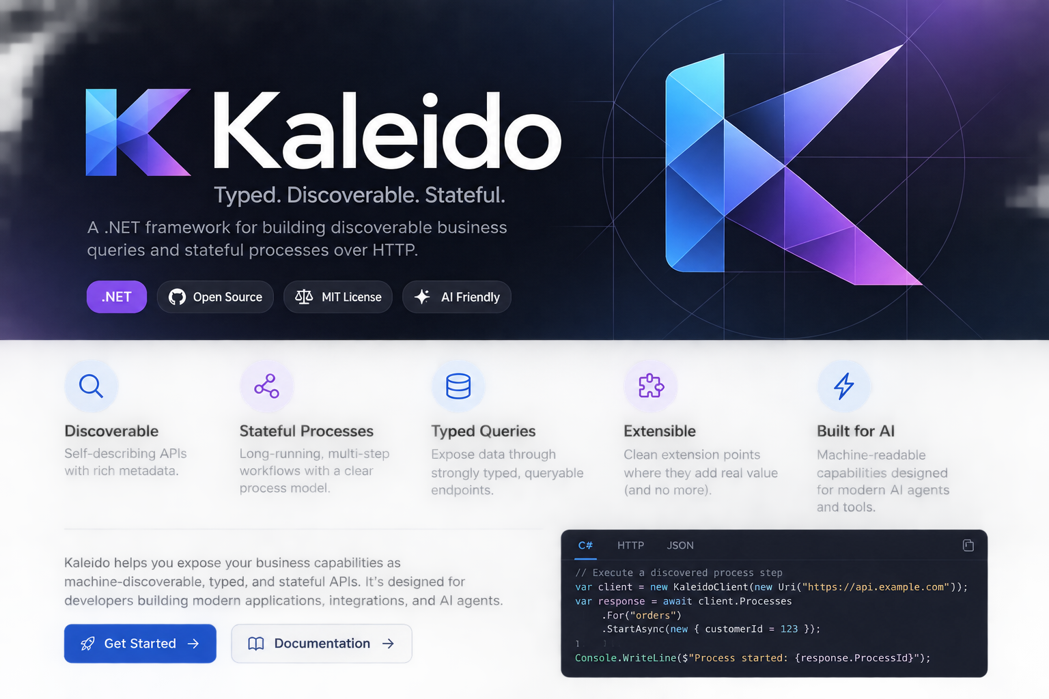
THE IDEA
AT A GLANCE
One contract layer for humans, applications, and AI.
01
Discover
What capabilities exist?
02
Invoke
How do I call them?
03
Continue
What comes next?
One business capability model.
Many consumers.

Slide 3


WHAT KALEIDO DOES
Three primitives make the system understandable
Kaleido turns ordinary .NET types into consistent, discoverable runtime contracts.
Queryable
Process
Registry
What does the business know?
What can the business do?
How does a consumer find it?
Typed views and parameters
Stateful, multi-step actions
Capability catalog and metadata
Search, filter, sort, and page
Dependencies and availability rules
Advertised execute and query URLs
Published field and constraint metadata
Next-step guidance through process state
Local and downstream aggregation
INFORMATION CAPABILITIES
ACTION CAPABILITIES
DISCOVERY CAPABILITIES
ORDINARY .NET TYPES → VALIDATED METADATA → CONSISTENT HTTP CAPABILITIES
Correlation • clients • observability • persistence
Kaleido — executive overview

Slide 4


OPERATING MODEL
DEFINE ONCE • REUSE EVERYWHERE
A shared capability layer—without replacing your platforms
Define business capabilities once, then let workflow tools, channels, partners, and agents consume the same contracts.
Workflow
engines
IVR / contact
center
Digital
channels
Partner
integrations
AI
agents
KALEIDO
Typed business capability layer
QUERYABLE
PROCESS
REGISTRY
information
actions + state
metadata + routes
validation • typed clients • process identifiers • correlation • telemetry
Member
Provider
Rules
Orders
Prior Auth
Reference
Kaleido complements orchestration platforms, channel runtimes, and interoperability standards.
The value is the shared contract between them.
Kaleido — executive overview

Slide 5
AI ENABLEMENT
DISCOVER → UNDERSTAND → ACT → CONTINUE
What an AI agent can do with Kaleido
Kaleido gives an agent a map of business capabilities—not unrestricted authority.
Discover
Understand
Choose
Execute
Continue
Read the registry
Inputs, outputs, constraints
Select a valid capability
Call the advertised URL
Use processId + next steps
ALREADY AVAILABLE
BEFORE AUTONOMOUS ACTION
Machine-readable operating context
Govern the decision boundary
Capability names, descriptions, schemas, and constraints
Authorization-aware discovery and allowlists
Advertised query and execution URLs
Side-effect, confirmation, and data-sensitivity metadata
Explicit process state and next-step guidance
Durable idempotency and concurrency guarantees
Structured results, errors, and correlation context
Registry freshness, redaction, and resource limits
AI opportunity: supervised tool use first; governed autonomy as production guarantees mature.

Slide 6
CURRENT DIRECTION
CURRENT FOCUS
Initial target consumers
Kaleido is the reusable capability layer beneath the systems that orchestrate work, interact with people, or exchange standards-based data.
WORKFLOW ENGINES
IVR / CONTACT CENTER
EXTERNAL INTEGRATIONS
Pega and similar platforms
Conversational and assisted channels
Da Vinci CRD · DTR · PAS
Keep case orchestration, SLAs, assignments, and human work in the workflow platform. Call Kaleido for reusable, typed business capabilities.
Use metadata to drive prompts and validation, preserve an explicit process ID, and resume work across transfers, agents, or digital handoffs.
Handle FHIR- and X12-oriented interactions at the edge, then map them into stable internal queries and process steps that can be reused elsewhere.
FEWER BESPOKE CONNECTORS
SHARED BUSINESS CONTRACTS
CONSISTENT PROMPTS
CROSS-CHANNEL CONTINUITY
STANDARDS AT THE EDGE
STABLE INTERNAL MODEL
Kaleido complements case management; it does not replace it.
The same backend action is available to voice, agent desktop, and web.
CRD discovers requirements, DTR gathers documentation, and PAS supports submission.
Complementary, not replacement.
Sources: Pega workflow automation • HL7 Da Vinci CRD 2.2.1, DTR 2.2.0, PAS 2.2.1
Kaleido — executive overview

Slide 7
ILLUSTRATIVE JOURNEY
BASED ON THE PRIORAUTH SAMPLE
One prior authorization process, many consumers
A single process can span multiple services while every channel uses the same metadata, validation, and state model.
CONSUMERS
PROCESS THREAD
processId
SHARED OUTCOME
Pega
Same metadata
IVR
Same validation
Web / app
Same process state
AI agent
Start
intake
Find
member
Capture
service
Select
provider
Complete
questions
Submit &
record
Same correlation
Da Vinci
intake
member
radiology
provider
configuration
history
Same observability
Same capability
contract
Queryable supplies context and reference data; Process manages the resumable business journey.
The channel can change without redefining the business capability.
Illustrative: service and workflow concepts are grounded in the repository’s PriorAuth sample.

Slide 8
EXECUTIVE TAKEAWAY
Standardize once.
Reuse everywhere.
Kaleido creates a common language between business services and the systems that need to use them.
Shared capability contracts
Less one-off integration
Resumable, observable work
Governed path to AI
A consistent way to expose queries and actions.
Channels reuse metadata, URLs, validation, and state.
Explicit process identity and correlation across services.
Supervised tool use now; safer autonomy as controls mature.
NEAR-TERM DIRECTION
01
PREVIEW
02
HARDEN
03
PROVE
04
SCALE
Publish and validate
consumer packages
State, idempotency,
privacy, authorization
Pega, IVR, and
Da Vinci adapters
Architecture and
tech-lead guidance
Kaleido — typed, discoverable, stateful business capabilities.

